Slide 1
THE EUROPEAN UNION
Babora Frančíková
Antonín Suk

Slide 2
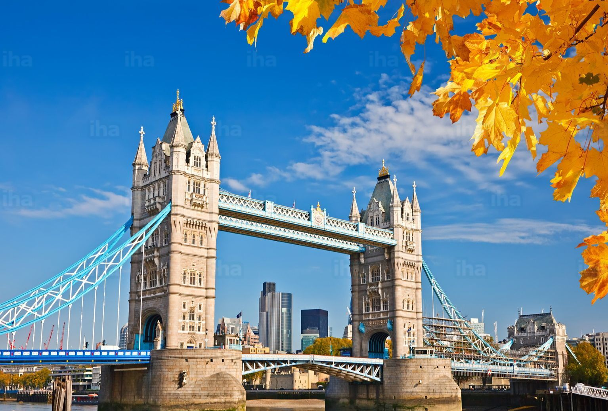
BASIC FACTS
28 member states
anthem: Ode to Joy
formally established in 1993
largest cities: Paris, London
capital: Brussels

Slide 3
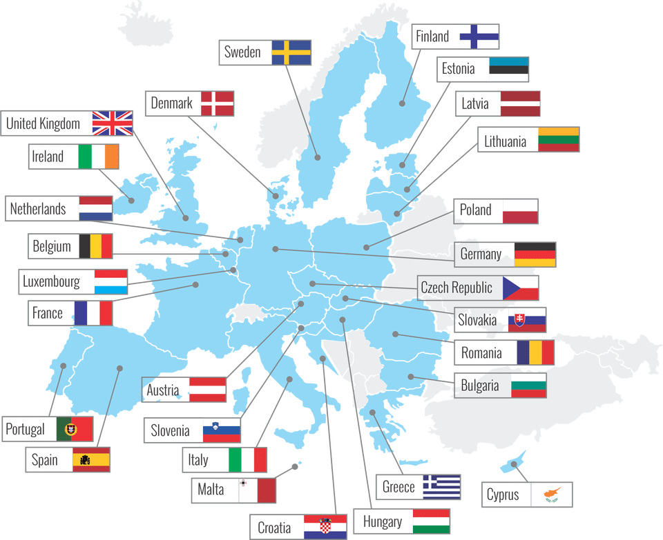

Slide 4
The aims and values ​​of the European Union
the fight against social exclusion and discrimination
the promotion of peace, the values of citizens
free movement of citizens, things and capital
ensuring freedom, security
legal state
democracy

Slide 5
Humanitarian aid
EU humanitarian aid annually receives more than 120 million people.
The EU institutions, together with the Member States of the Union, are the largest donors of humanitarian aid in the world.
The Treaty of Lisbon says - to help regardless of nationality, religion or gender
assistance is provided by over 200 partner organizations
a non-governmental organization
International organization
organization of the Red Cross
agencies of the United Nations.
https://europa.eu/european-union/topics/humanitarian-aid-civil-protection_cs

Slide 6
SURVEY
Zde bychom udělali vyhodnocení kvízu.
RESEARCH

Slide 7
VIDEO
Otázky:
Řekni první tři věci, které tě napadnou, když slyšíš EU.
Kdy vstoupila ČR do EU?
Poznáš tuto hudební skladbu? Kdo ji napsal? (Oda na radost)
Jak se jmenoval předchůdce EU?
Který stát v nejbližší době nebude součástí EU?
Považuješ za pozitivní, že jsme součástí? Zdůvodni

Slide 8
HISTORY

Slide 9
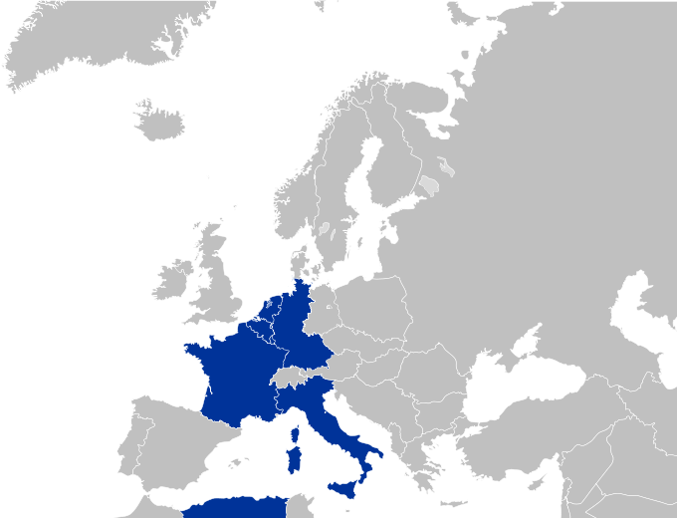
EUROPEAN COAL AND STEEL COMUNITY
1945
Mainly for free trade for coal and steel (important materials)
Netherlands, Luxemburg, Belgium, Italy, France, West Germany
Ended in 2002

Slide 10
EUROPEAN ECONOMIC COMUNITY, EURATOM
1958 EEC
To set free trade
1957 Euratom
for peaceful use of atomic energy
Concluded in 1967: European Communities

Slide 11
ANOTHER MAJOR ESTABLISHMENTS
1958 – European bank of investment (later European central bank)
1979 – ECU
Currency for transactions
1985 - Schengen Agreement
Free borders among members, protection
1993 - Maastricht Treaty
Free move for people, commodities and money
Also EURO was aprooved
1999 - EURO

Slide 12
1952 - 1958

Slide 13
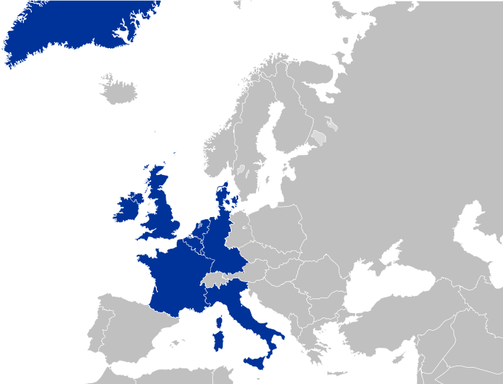
1973

Slide 14
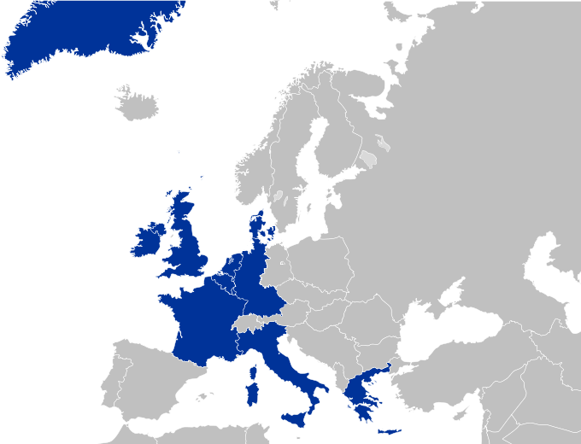
1981

Slide 15
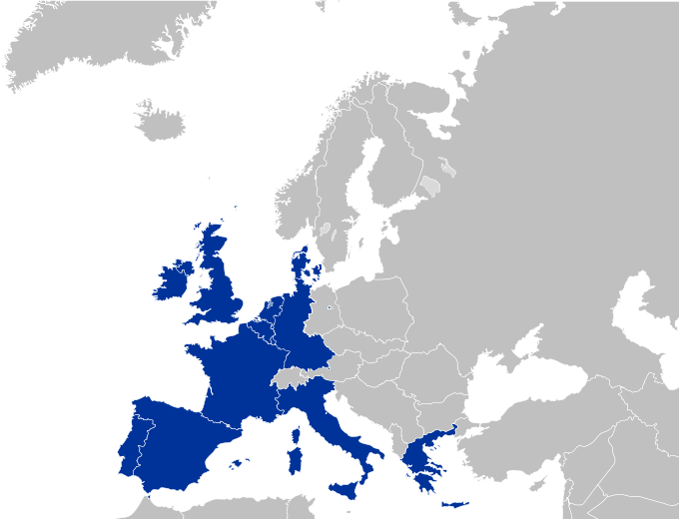
1986

Slide 16
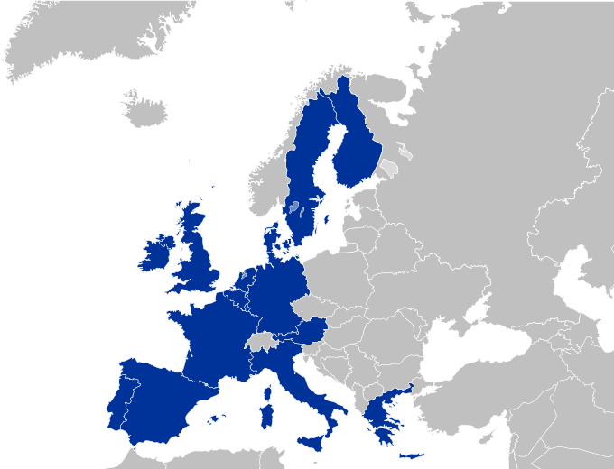
1995

Slide 17
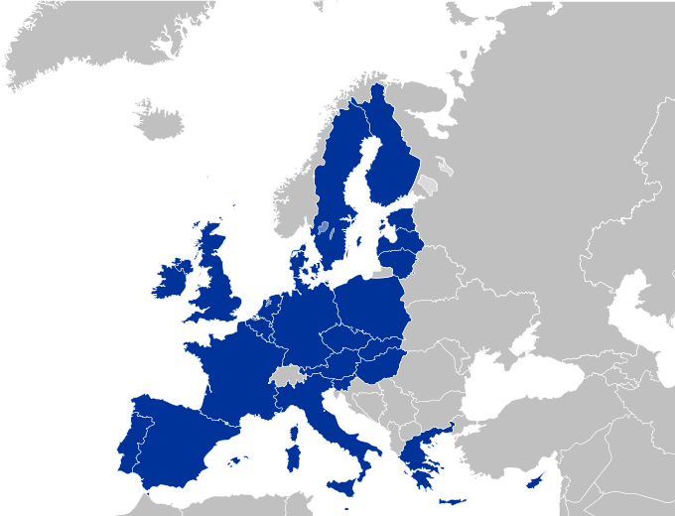
2004

Slide 18
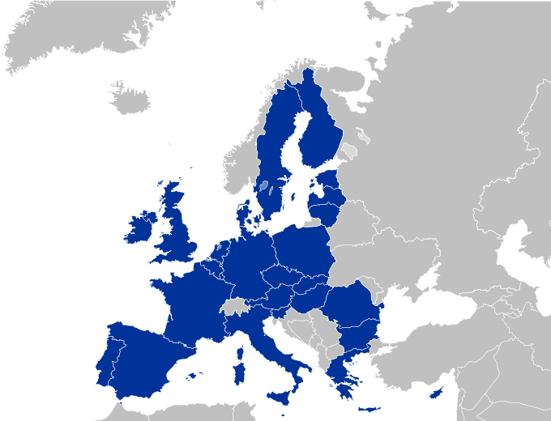
2007

Slide 19
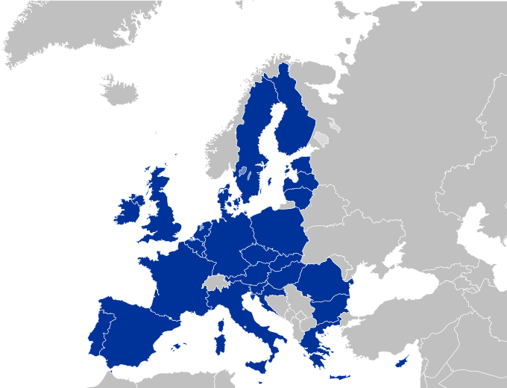
2013

Slide 20
SUMMARY
Without EU, we could not be here, so we hope you have learned some fact about EU from our presentation. We hope it was a little USE:FUL for you
THANKS FOR YOUR ATTENTION

