Slide 1
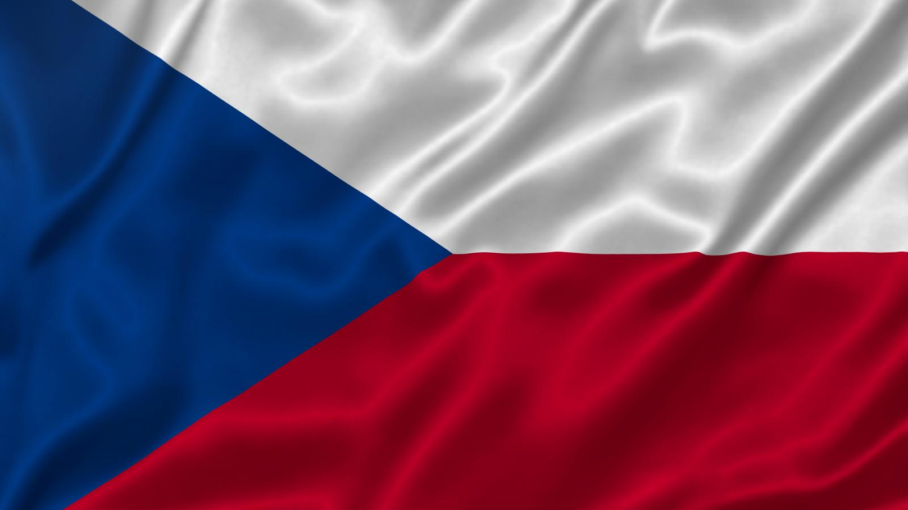
The Czech Republic

Slide 2
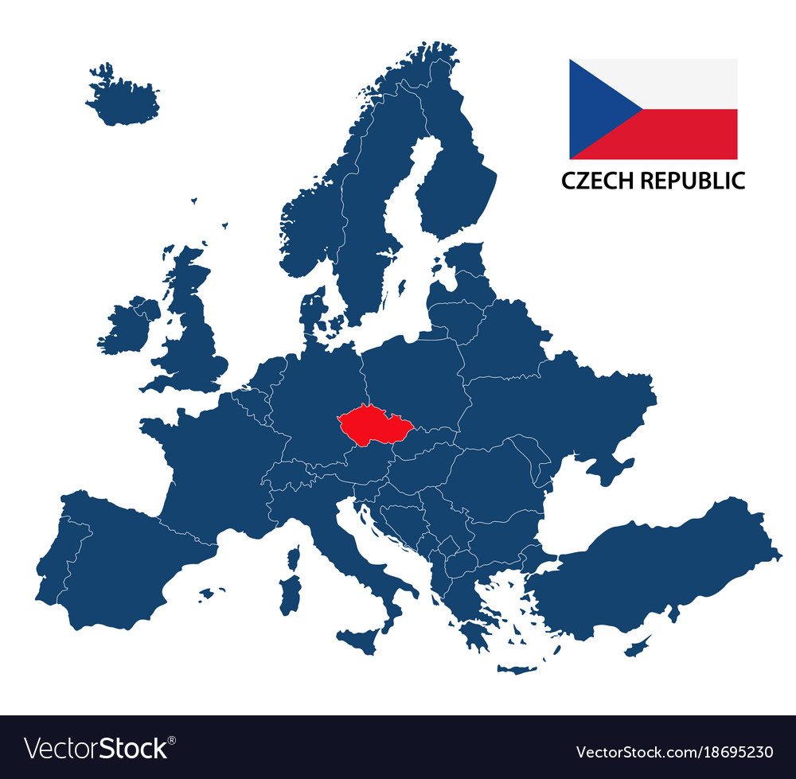
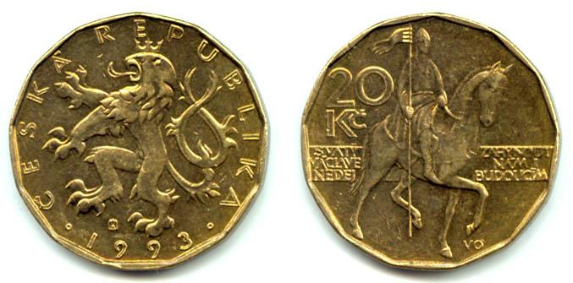
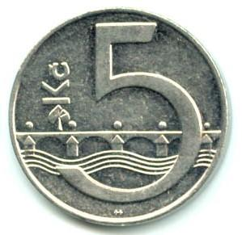
Basic facts
Official language: Czech
Capital: Prague
Form of government: Parliamentary Republic
Population: 10 578 820
National anthem: Where is my home?
Currency: Czech crown

Slide 3
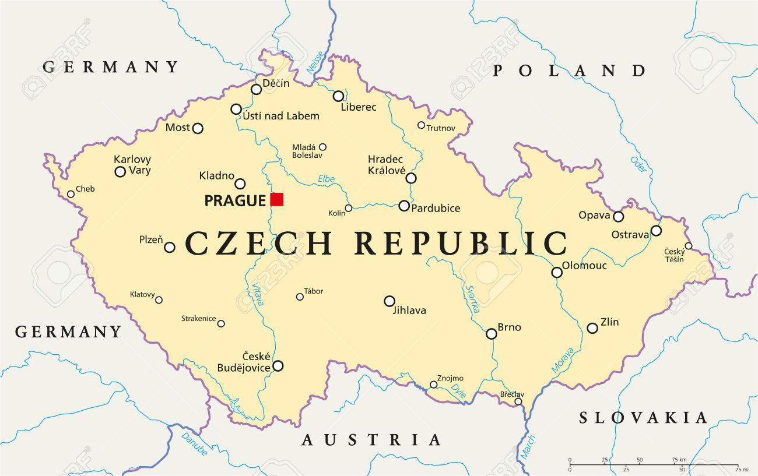

Slide 4
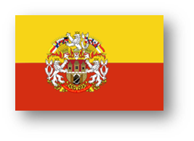
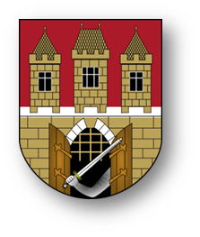
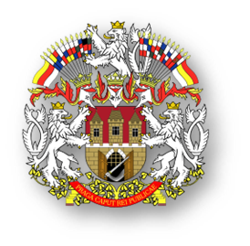
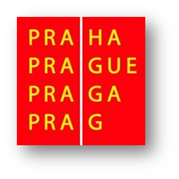
Prague
The capital city
More than 1,3 million people
496 km²

Slide 5
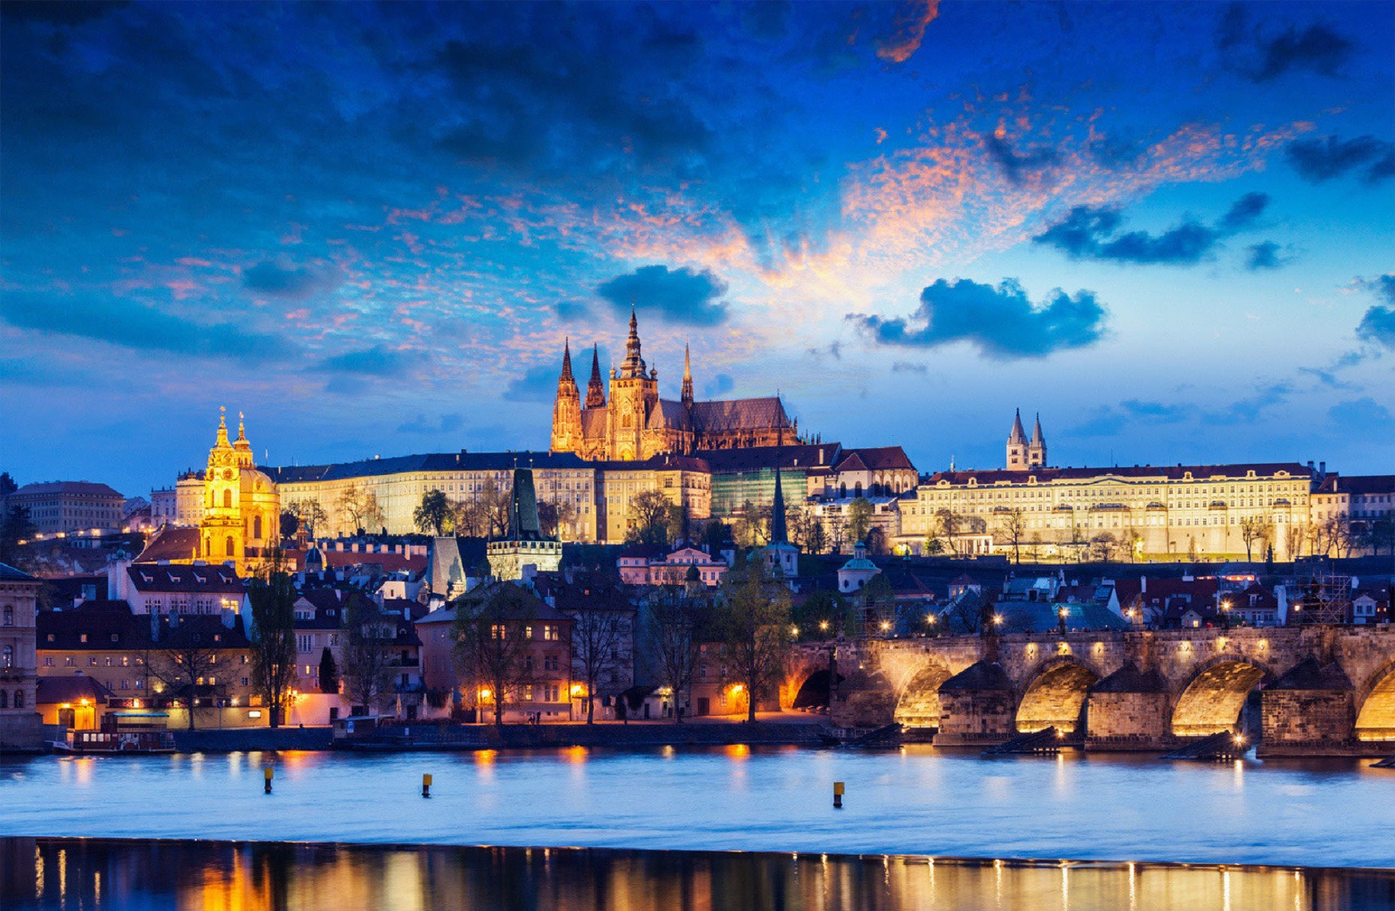
Notes:
these pictures are from Prague. Famous places like Charles Bridge, Prague Castle and Golden street

Slide 6
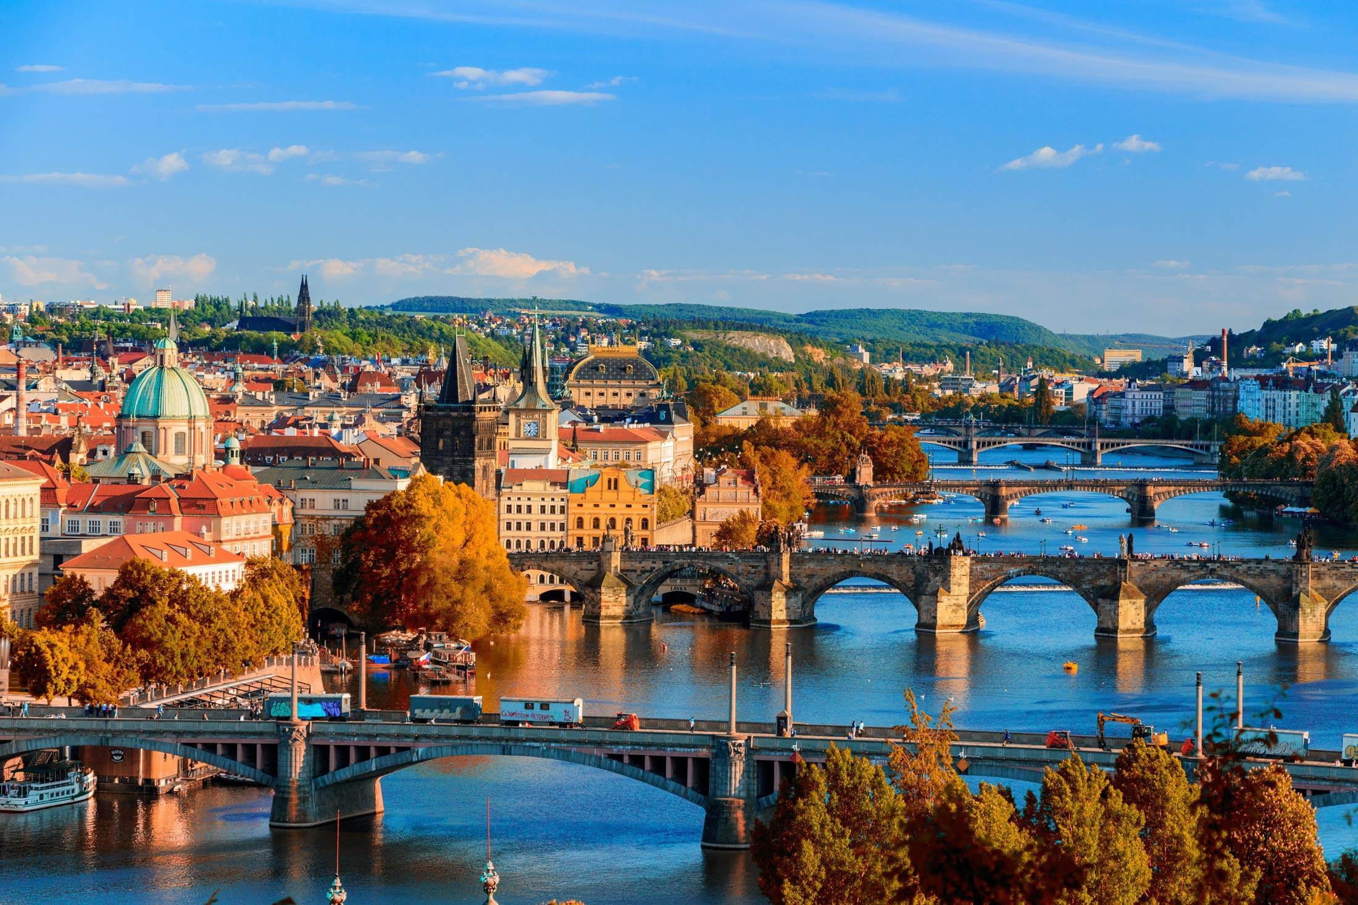
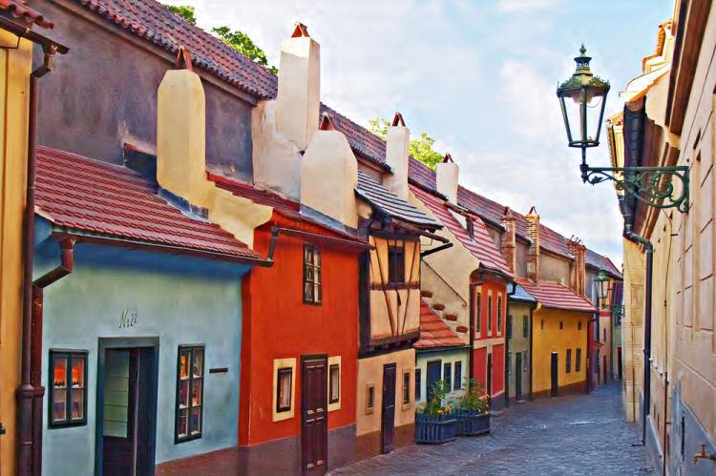

Slide 7
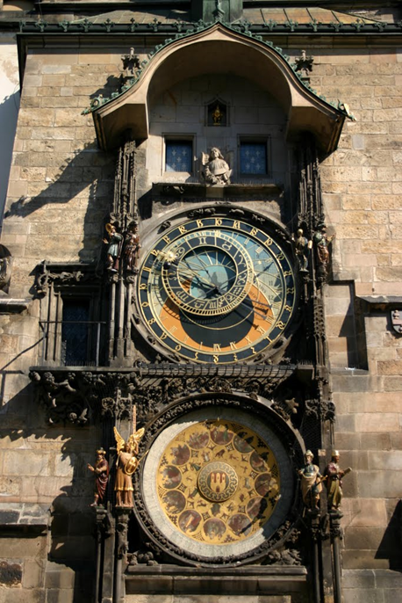
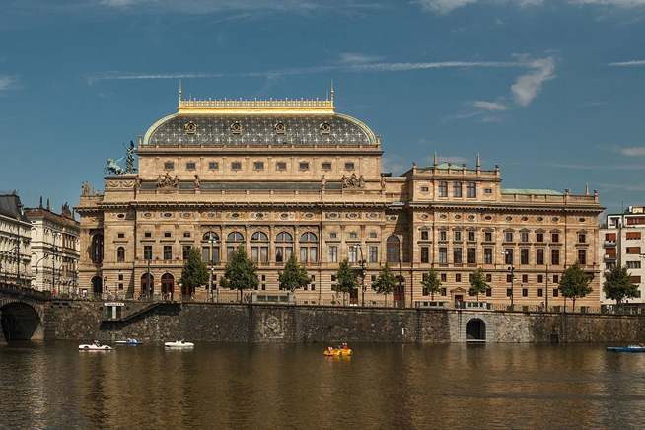
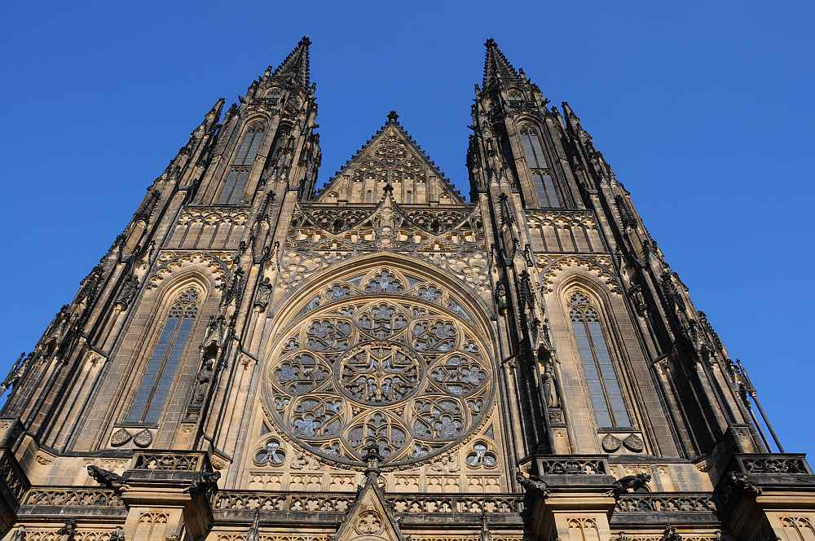

Slide 8
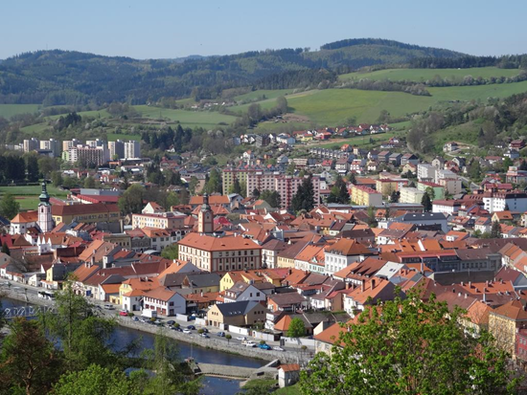
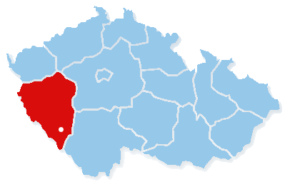
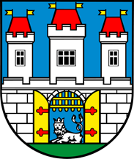
Sušice
about 11 000 people
lies in Pilsen region
Notes:
Now lets talk about smaller town in Pilsen region, its here on the map. You can see our city emblam and this picture is from beautiful place, where can we look to all of the Sušice.

Slide 9
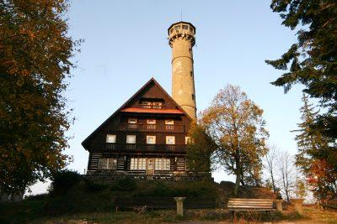
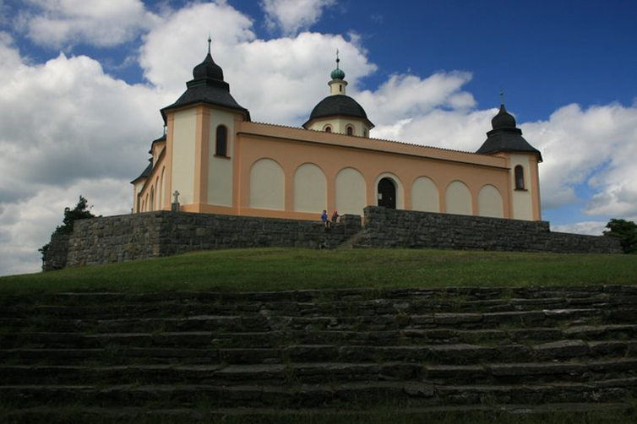
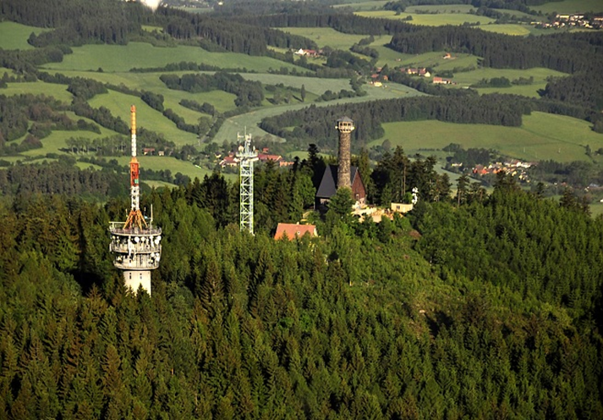
Notes:
There are that places, which I was talking about. Svatobor and Andělíček (for you maybe chapel of the holy angel) https://www.youtube.com/watch?v=OXURQKbyPBg#action=share

Slide 10
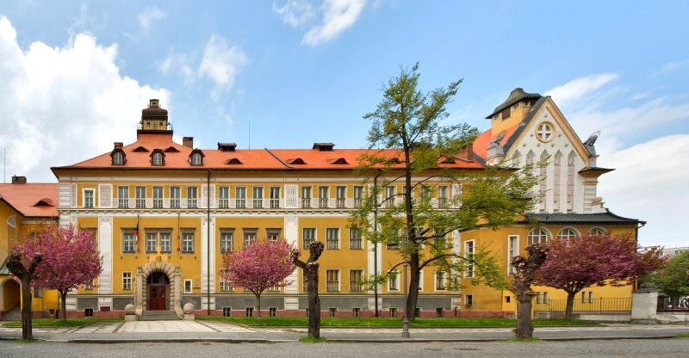
Gymnázium Sušice
316 students
12 classes

Slide 11
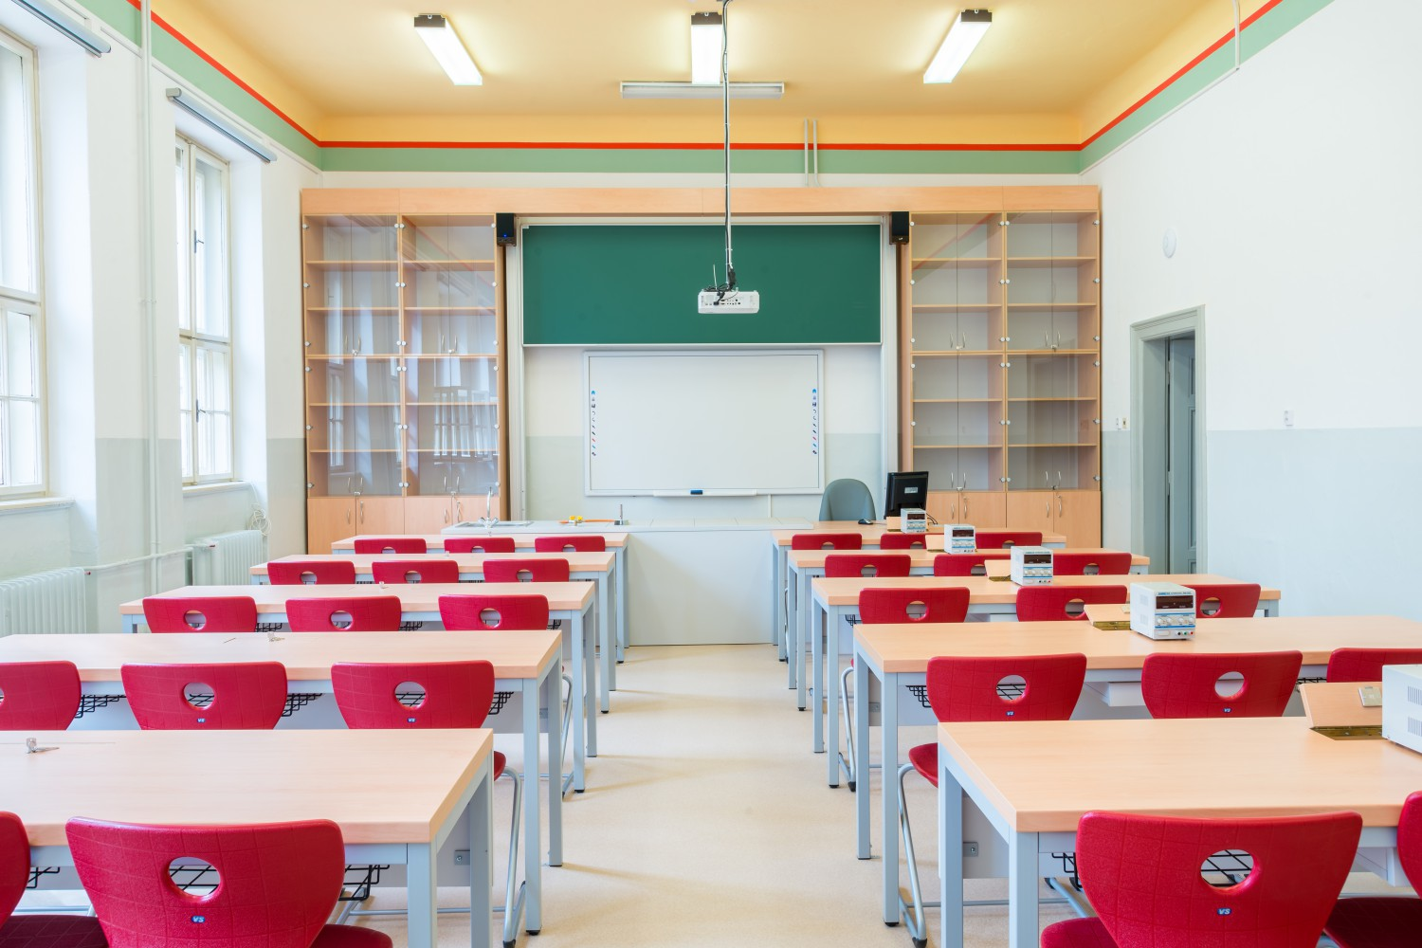
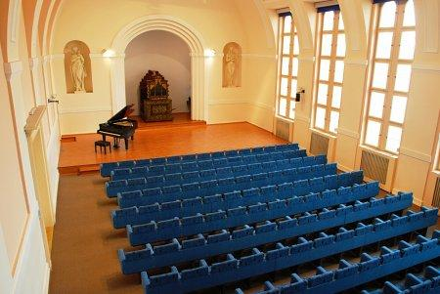

Slide 12
THANK YOU FOR YOUR ATTENTION! ANY QUESTIONS?

